Slide 1
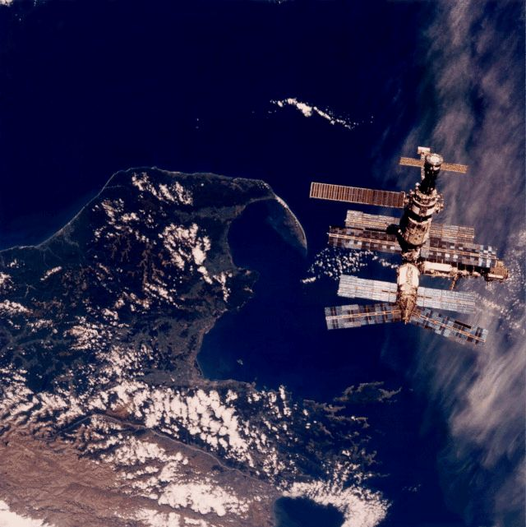
Engineering 112
Foundations of Engineering

Slide 2
Student Information Sheet

Slide 3
Engineering Disciplines
Electrical Engineering
Civil Engineering
Mechanical Engineering
Industrial Engineering
Aerospace Engineering
Chemical Engineering
Biomedical Engineering
Materials Engineering
Agricultural Engineering
Nuclear Engineering
Architectural Engineering
Petroleum Engineering
Engineering Technology

Slide 4
Course Syllabus
Purpose
Material
Exams
Grading
Course Policies

Slide 5
Objectives of ENGR 112
Develop a better understanding of engines
Become a better problem solver
Develop a mastery of unit analysis
Improve your mathematics skills
Prepare you for statics and dynamics
Develop teaming skills

Slide 6
Course Calendar

Slide 7
A Brief History of EGR111/112
These courses were added to the curriculum at TAMU in the early 1990’s.
12 disciplines require these courses.
The courses were first taught at SFA starting in the Fall of 2002.
They are part of an articulation agreement with TAMU.
They also transfer to other universities.

Slide 8
Course | Description
PHY108 | Introduction to PHY/EGR
EGR111 | Foundations I
EGR112 | Foundations II
EGR215 | Electrical Engineering
EGR343 | Digital Systems
EGR250 | Engineering Statics
EGR321 | Engineering Dynamics

Slide 9
Course | Pre-EGR | DUAL | Minor
PHY108 |  |  | 
EGR111 |  |  | 
EGR112 |  |  | 
EGR215 | ~ | ~ | 
EGR342 | ~ | ~ | 
PHY250 | ~ |  | 
PHY321 | ~ |  | 

Slide 10
Teaming Expectations
Many of the activities in ENGR 112 require collaboration with other class members
Each student will be assigned to a team
All students will receive team training

Slide 11
Before Wednesday…
Get a Note Book and Text Book
Double Check you Schedule
  4th Class Day
  12th Class Day
  Mid-Semester
Complete Problems 1 – 5 on HW1

Slide 12
Can you boil water at room temperature?

Slide 13
How can you design a room that is completely silent?

Slide 14
Thermodynamics
Chapter 11

Slide 15
Thermodynamics
Developed during the 1800’s to explain how steam engines converted heat into work.
Thought Questions:
  Is heat just like light and sound?
  Is there a “speed of heat”?
    Answer: Not really.

Slide 16
11.1 Forces of Nature
Gravity Force
Electromagnetic Force
Strong Force
Weak Force
Nuclear Forces

Slide 17
Chapter 11 - Thermodynamics
11.1 - Forces of Nature
11.2 - Structure of Matter
11.3 - Temperature
11.4 - Pressure
11.5 - Density
11.6 - States of Matter

Slide 18
11.2 Structure of Matter
Protons
  Atomic Number - number of protons
Neutrons
  nuclear glue
Electrons
  Valence Electrons - those far from the nucleus
Atoms, Molecules, and a Lattice
  Amorphous - random arrangement of atoms
  Crystal - atoms are ordered in a lattice

Slide 19
Which is colder?
Metal or Wood?

Slide 20
11.3 Temperature
Measured in Fahrenheit, Celsius, and Kelvin
Rapidly moving molecules have a high temperature
Slowly moving molecules have a low temperature

Slide 21
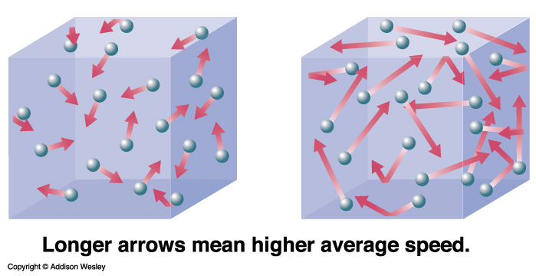
Cool Hot

Slide 22
What is “absolute zero”?

Slide 23
Temperature Scales
Fahrenheit
Celsius
Kelvin
Boiling Point
of Water
212°F
100°C
373 K
Freezing Point
of Water
273 K
32°F
0°C
Absolute Zero
-459°F
-273°C
0 K

Slide 24
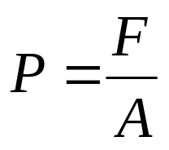
11.4 Pressure
Pressure - force per unit area
It has units of N/m² or Pascals (Pa)
F
A
Impact
Weight
Notes:
change impact and weight to something cool like bevo...

Slide 25
Pressure
What are the possible units for pressure?
  N/m²
  Pascal 1 Pa = 1 N/m²
  atm 1 atm = 1 × 10⁵ Pa
  psi 1 psi = 1 lb/inch²
  mm Hg 1 atm = 760 mm Hg
Notes:
change impact and weight to something cool like bevo...

Slide 26
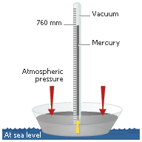

Slide 27
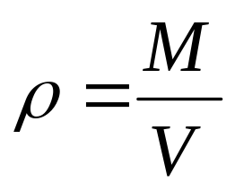
11.5 Density
Density - mass per unit volume
It has units of g/cm³
Low density
High density
Notes:
fill boxes

Slide 28
11.6 States of Matter
Solid Liquid
Gas Plasma

Slide 29
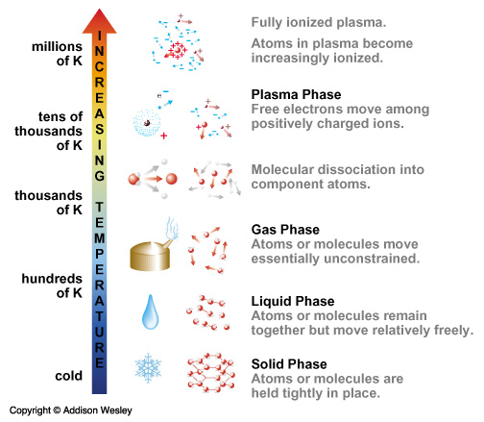

Slide 30
State of Matter Definitions
Phase Diagram
  Plot of Pressure versus Temperature
Triple Point
  A point on the phase diagram at which all three phases exist (solid, liquid and gas)
Critical Point
  A point on the phase diagram at which the density of the liquid a vapor phases are the same

Slide 31
Figure 11.8 - Phase Diagram
Pressure
Freezing
Melting
P_{critical}
Liquid
Critical
Point
Solid
Condensation
Plasma
Boiling
P_{triple}
Triple
Point
Sublimation
Gas
Vapor
T_{triple}
T_{critical}
Temperature

Slide 32
Questions
Is it possible to boil water at room temperature?
  Answer: Yes. How?
Is it possible to freeze water at room temperature?
  Answer: Maybe. How?

Slide 33
Gas Laws
Perfect (ideal) Gases
Boyle’s Law
Charles’ Law
Gay-Lussac’s Law
Mole Proportionality Law

Slide 34
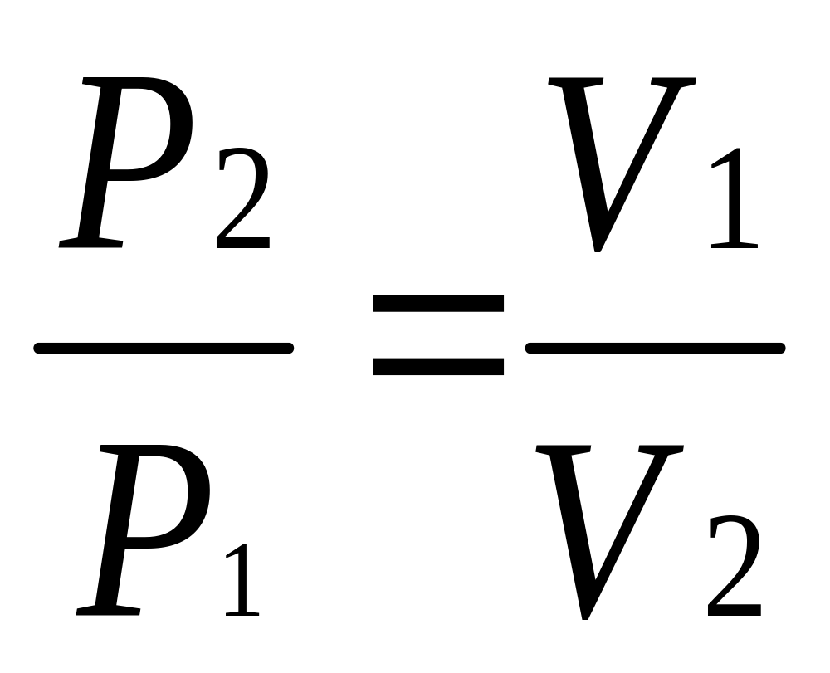
Boyle’s Law
P₁
V₁
P₂
V₂
T = const
n = const

Slide 35
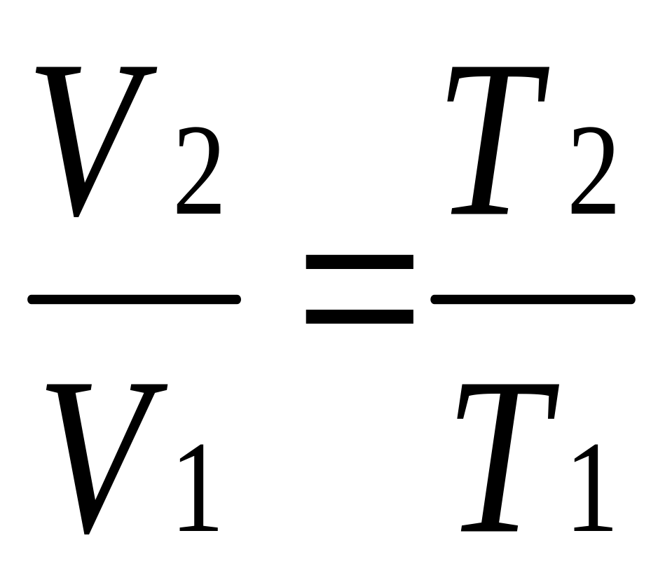
Charles’ Law
T₁
V₁
T₂
V₂
P = const n = const

Slide 36
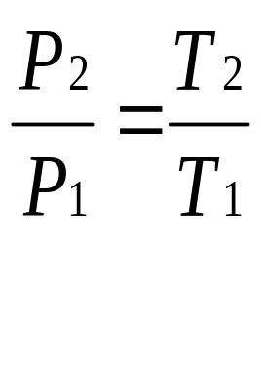
Gay-Lussac’s Law
T₁
P₁
T₂
P₂
V = const n = const

Slide 37
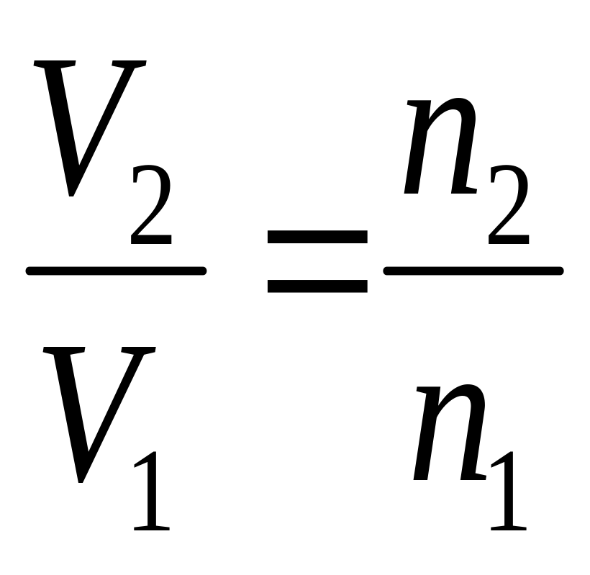
Mole Proportionality Law
n₁
V₁
n₂
V₂
T = const
P = const

Slide 38
Thermodynamics
Chapter 11
Homework 1

Slide 39
Boyle’s Law
P₁
V₁
P₂
V₂
T = const
n = const

Slide 40
Charles’ Law
T₁
V₁
T₂
V₂
P = const n = const

Slide 41
Gay-Lussac’s Law
T₁
P₁
T₂
P₂
V = const n = const

Slide 42
Mole Proportionality Law
n₁
V₁
n₂
V₂
T = const
P = const

Slide 43
Perfect Gas Law
The physical observations described by the gas laws are summarized by the perfect gas law (a.k.a. ideal gas law)
PV = nRT
    P = absolute pressure
    V = volume
    n = number of moles
    R = universal gas constant
    T = absolute temperature

Slide 44
Table 11.3: Values for R
Pa·m
3
J
8
.
314
8
.
314
mol·K
mol·K
atm·L
cal
0
.
08205
1.987
mol·K
mol·K
Work Problem 11.8

Slide 45
Thermodynamics
Chapter 11
Movie R.A.T.

Slide 46
RAT Movies
For the movies that follow, identify the gas law as a team.
Only the recorder should do the writing.
Turn in the team’s work with the team name at the top of the page.

Slide 47
Balloon Example (Handout)
A balloon is filled with air to a pressure of 1.1 atm.
The filled balloon has a diameter of 0.3 m.
A diver takes the balloon underwater to a depth where the pressure in the balloon is 2.3 atm.
If the temperature of the balloon does not change, what is the new diameter of the balloon? Use three significant figures.

Slide 48
Volumes?
Cube
  V=a³
Sphere
  V=⁴/₃ π r³

Slide 49
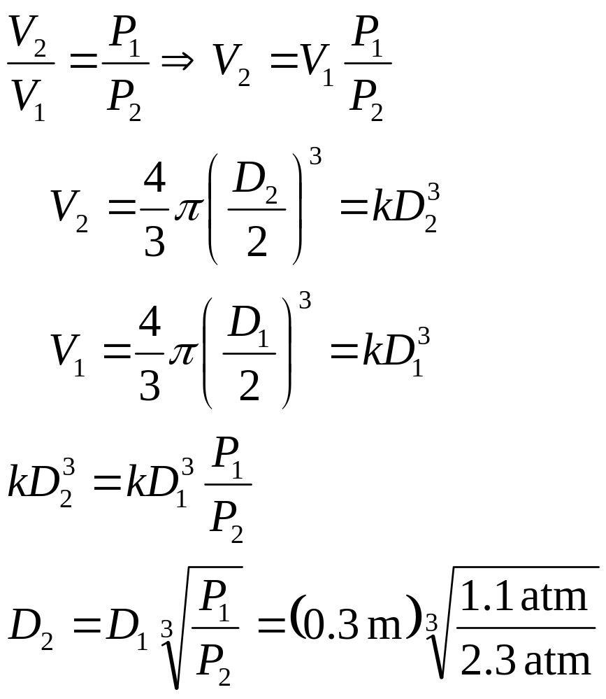
Solution
P₁ = 1.1 atm
D₁ = 0.3 m
P₂ = 2.3 atm
D₂ = ?
= 0.235 m

Slide 50
Work
Work = Force × Distance
W = F Δx
The unit for work is the Newton-meter which is also called a Joule.

Slide 51
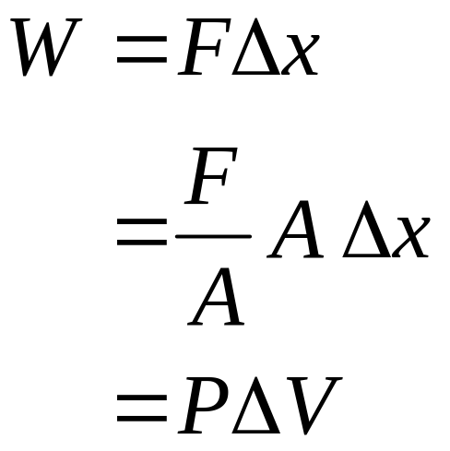
Hydraulic Work
Δx
F
ΔV
A
P
F
P
P = const

Slide 52
Joule’s Experiment
Joule showed that mechanical energy could be
converted into heat energy.
ΔT
M
F
Δx
H₂O
W = FΔx

Slide 53
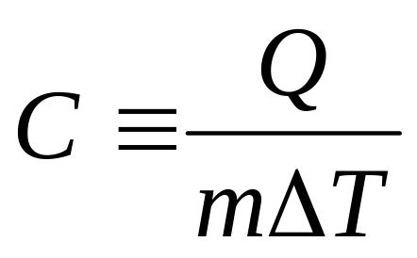
Heat Capacity Defined
Q - heat in Joules or calories
m - mass in kilograms
ΔT - change the temperature in Kelvin
C has units of J/kg K or kcal/kg K
1 calorie = 4.184 Joules

Slide 54
ΔT
m
F
Δx
H₂O
W = FΔx
1 kcal= 4184 J
Problem 11.9

Slide 55
Where did the energy go?
By the First Law of Thermodynamics, the energy we put into the water (either work or heat) cannot be destroyed.
The heat or work added increased the internal energy of the water.
  This is the energy stored in the atoms and molecules that make up the water; they move faster.

Slide 56
Heat Capacity
An increase in internal energy causes a rise in the temperature of the medium.
Different mediums require different amounts of energy to produce a given temperature change.

Slide 57
Myth Busters - Cold Coke
Do you burn more calories drinking a warm or cool drink?
How many calories do you burn drinking a cold Coke?
  Assume that a coke is 335ml and is chilled to 35°F and is about the same density and heat capacity as water. The density of water is 1g/cm³.
  1 kcal=4184 J 1ml=1cm³
  The heat capacity of water is 1 calorie per gram per degree Celsius (1 cal/g-°C).
  T_{C} = (5/9)*(T_{F}-32)
http://en.wikipedia.org/wiki/Calorie

Slide 58
Thermodynamics
Chapter 11

Slide 59


11.11 Energy
Energy is the ability to do work.
It has units of Joules.
It is a “Unit of Exchange”.
Example
  1 car = $20k
  1 house = $100k
  5 cars = 1 house
=

Slide 60
11.11 Energy Equivalents
What is the case for nuclear power?
  1 kg coal » 42,000,000 joules
  1 kg uranium » 82,000,000,000,000 joules
  1 kg uranium » 2,000,000 kg coal!!

Slide 61
11.11 Energy
Energy has several forms:
  Kinetic
  Potential
  Electrical
  Heat
  etc.

Slide 62
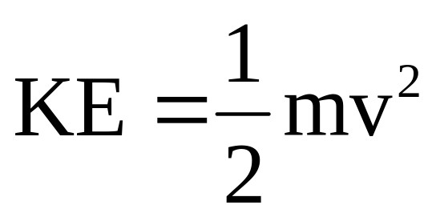
Kinetic Energy
Kinetic Energy is the energy of motion.
Kinetic Energy = ½ mass × speed²

Slide 63
Potential Energy
The energy that is stored is called potential energy.
Examples:
  Rubber bands
  Springs
  Bows
  Batteries
  Gravitational Potential PE=mgh

Slide 64



100 kg
1 meter
100 kg
100 kg
nail

Slide 65
11.11.3 Energy Flow
Heat is the energy flow resulting from a temperature difference.
Note: Heat and temperature are not the same.

Slide 66
Heat Flow
T = 100ºC
Temperature
Profile in Rod
T = 0ºC
Heat
Vibrating copper atom
Copper rod

Slide 67
11.12 Reversibility
Reversibility is the ability to run a process back and forth infinitely without losses.
Reversible Process
  Example: Perfect Pendulum
Irreversible Process
  Example: Dropping a ball of clay

Slide 68
“Movie Making”
Reversibility
  Movies of reversible phenomena appear the same when played forward and backward.
Irreversibilities
  The opposite is true.

Slide 69
Team Exercise (3 minutes)
Write down three examples of reversible processes.
Write down three examples of irreversible processes.
Your recorder will submit your answers.

Slide 70
Reversible Process
Examples:
  Perfect Pendulum
  Mass on a Spring
  Dropping a perfectly elastic ball
  Perpetual motion machines
  More?

Slide 71
Irreversible Processes
Examples:
  Dropping a ball of clay
  Hammering a nail
  Applying the brakes to your car
  Breaking a glass
  More?

Slide 72
Example: Popping a Balloon
Not reversible unless
energy is expended

Slide 73
Sources of Irreversibilities
Friction (force drops)
Voltage drops
Pressure drops
Temperature drops
Concentration drops

Slide 74
First Law of Thermodynamics
  energy can neither be created nor destroyed

Slide 75
Second Law of Thermodynamics
  naturally occurring processes are directional
  these processes are naturally irreversible

Slide 76
Third Law of Thermodynamics
  a temperature of absolute zero is not possible

Slide 77
Heat into Work
W
T_{hot}
Heat
Engine
T_{cold}
Q_{hot}
Q_{cold}

Slide 78
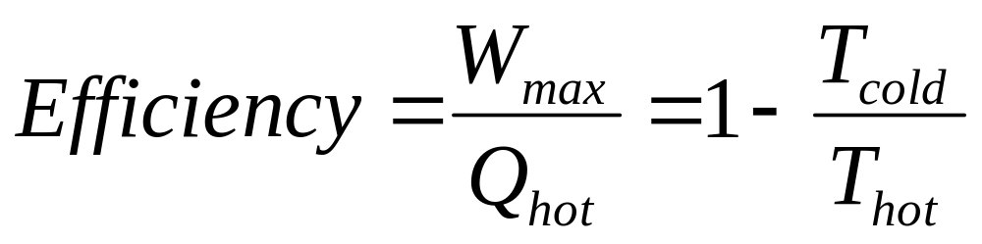
Carnot Equation: Efficiency
The maximum work that can be done by a heat engine is governed by:

Slide 79
Team Exercise (3 minutes)
What is the maximum efficiency that a heat engine can have using steam and an ice bath?
W
T_{hot}
Heat
Engine
T_{cold}

Slide 80
Work into Heat
Although there are limits on the amount of heat converted to work, work may be converted to heat with 100% efficiency.

Slide 81
Chapter 12

Slide 82
Heat Capacity for Constant Volume Processes (C_{v})
insulation
ΔT
Heat, Q
added
m
m
Heat is added to a substance of mass m in a fixed volume enclosure, which causes a change in internal energy, U. Thus,
Q = U₂ - U₁ = ΔU = m C_{v} ΔT
The v subscript implies constant volume

Slide 83
Heat Capacity for Constant Pressure Processes (C_{p})
Δx
ΔT
Heat, Q
added
m
m
Heat is added to a substance of mass m held at a fixed pressure, which causes a change in internal energy, U, AND some PV work.

Slide 84
C_{p} Defined
Thus,
Q = ΔU + PΔV = ΔH = m C_{p} ΔT
The p subscript implies constant pressure
H, enthalpy. is defined as U + PV,
so ΔH = Δ(U+PV) = ΔU + VΔP + PΔV = ΔU + PΔV
Experimentally, it is easier to add heat at constant pressure than constant volume, thus you will typically see tables reporting C_{p} for various materials (Table 21.1 in your text).

Slide 85
Individual Exercises (5 min.)
Calculate the change in enthalpy per unit lb_{m} of nitrogen gas as its temperature decreases from 1000 ºR to 700 ºR.
Two kg of water (C_{v}=4.2 kJ/kg K) is heated by 200 BTU of energy. What is the change in temperature in K? In ºF?

Slide 86
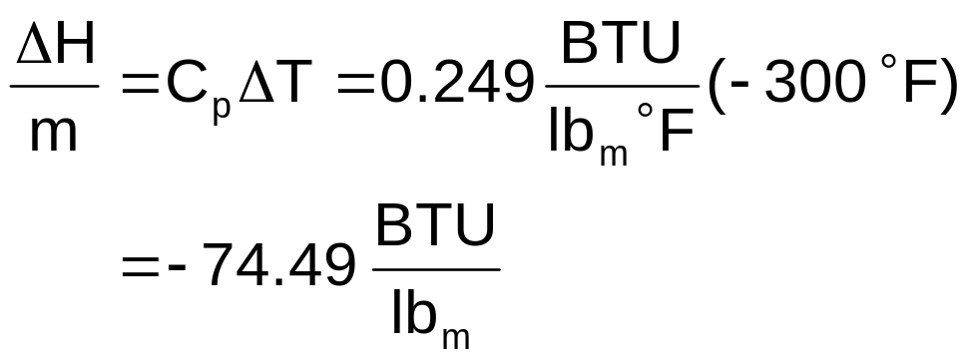
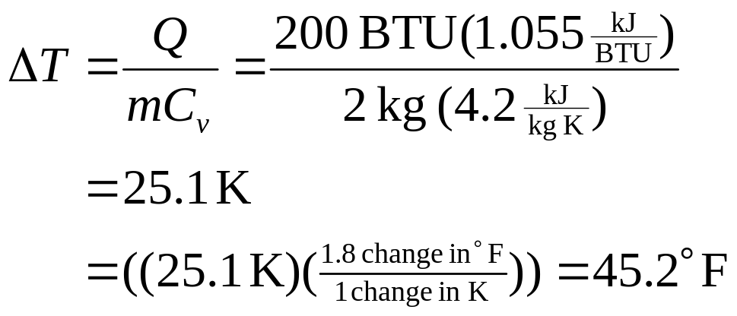
Solution
From table 21.2, C_{p} for N₂ = 0.249 BTU/lb_{m}ºF. Note that since ºR = ºF + 459.67, then ΔT ºR = ΔT ºF, so
Recall, we are referring to
a temperature CHANGE

Slide 87
Homework

Slide 88
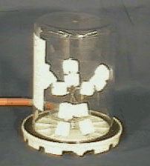
Exercise
A stick man is covered with marshmallows and placed in a sealed jar.
What will happen to the marshmallow man when the jar is evacuated? Why?
http://demoroom.physics.ncsu.edu/html/demos/88.html

Slide 89

Solution
Click to activate, then click play
Suggestion: view at 200%

Slide 90
Other Homework Questions

Slide 91
What’s next?

Slide 92
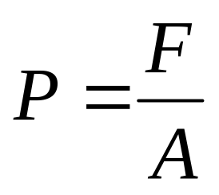
Example Problem
A cube of aluminum measures 20 cm on a side sits on a table.
Calculate the pressure (N/m²) at the interface.
Note: Densities may be found in your text.

Slide 93
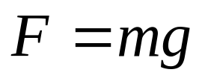
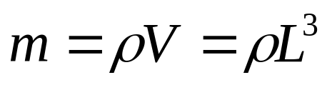
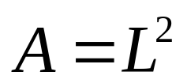
Solution
L = 0.2 m
L = 0.2 m
L = 0.2 m

Slide 94
Heat/Work Conversions
Heat can be converted to work using heat engines
  Jet engines (planes)
  steam engines (trains)
  internal combustion engines (automobiles)

Slide 95
Team Exercise (2 minutes)
On the front of the page write down 2 benefits of working in a team.
On the back write down 1 obstacle that we must overcome to work in engineering teams.
You have two minutes…

Slide 96
Why Teamwork
Working in groups enhances activities in active/collaborative learning
Generate more ideas for solutions
Division of labor
Because that’s the way the real world works!!
  Industry values teaming skills

Slide 97
Why Active/Collaborative Learning
Active
  countless studies have shown improvement in:
    short-term retention of material,
    long-term retention of material,
    ability to apply material to new situations
Collaborative
  by not wasting time on things you already know we can make the best use of class time

Slide 98
Teamwork Obstacles
What are some potential problems with teamwork?
  “I’m doing all of the work.”
    Solution: It is part of your team duties to include everyone in a team project.
  “I feel like I’m teaching my teammates.”
    Exactly. By explaining difficult concepts to your team members your grasp of difficult concepts can improve.
  “What if I don’t get along with my teammates.”
    Solution: This is a problem that all workers have at some point.
    The team may visit with the instructor during office hours to iron out differences.

Slide 99
Project One
The Rubber Band Heat Engine

Slide 100
Example Problems from Homework

Slide 101
Let’s take notes…

Slide 102
Boyle’s Law
P₁
V₁
P₂
V₂
T = const
n = const

Slide 103
Charles’ Law
T₁
V₁
T₂
V₂
P = const n = const

Slide 104
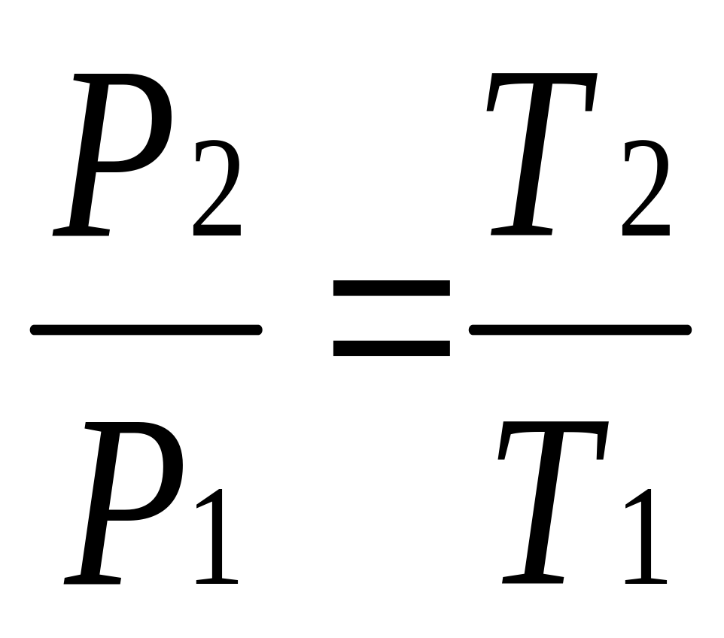
Gay-Lussac’s Law
T₁
P₁
T₂
P₂
V = const n = const

Slide 105
Mole Proportionality Law
n₁
V₁
n₂
V₂
T = const
P = const

Slide 106
Volume Team Exercise
Work the problem on the next slide in 3 minutes.
Then spend 3 minutes discussing it as a team.
Only the recorder should do the writing.
Turn in the team’s work with the team name at the top of the page.

Slide 107
Problems
Homework 1
  11
  12
  13
In-class Assignment
  Problem 1

Slide 108
Problems
Homework 1
  14
In-class Assignment
  Problem 2

